Slide 1
23-30 September 2016

Slide 2
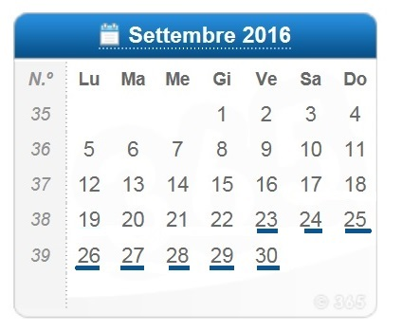
GENERAL INFORMATION
The application is for the 2016 World Championship.
The class of race is Marblehead.
The dates for championship are: 23-30 September
in Limone sul Garda - Brescia - .
In the locality there are no events for the periods indicated within two weeks, then there will be no difficulty for flights or accommodation and structures are ready and equipped to accommodate guests.

Slide 3
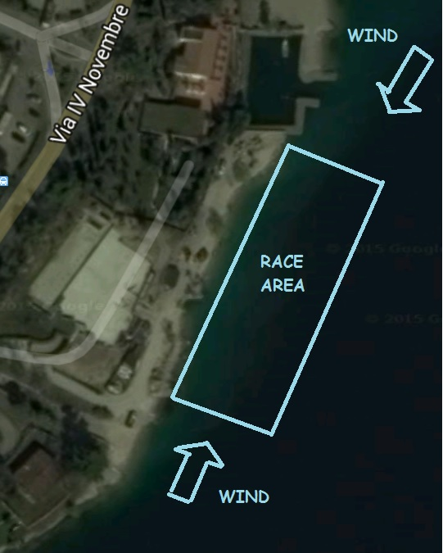
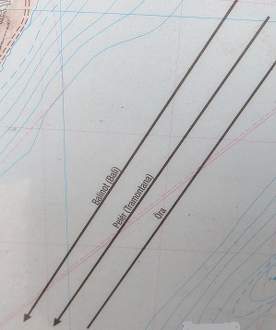
The maps of the location propose is:
Latitude: 45°48‘ N
Longitude: 10°47‘ E
During the period that the championship prevailing wind are thermally generated coming from South.
It comes up at around 12.00 and blows constantly until 19.00.
Wind speed ranges from 8 to 14 knots.
In the morning we have a light
thermal breeze from 8.00 until
around 10.00 coming mainly
from North but a little instable.
Wind speed ranges from
2 to 8 knots.

Slide 4
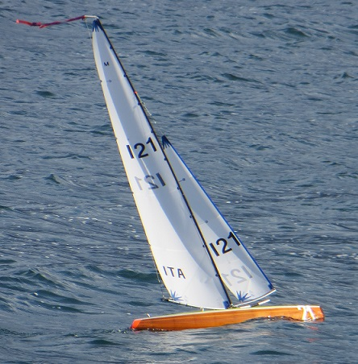
This informations concerning the location of Limone
sul Garda.
The minimum and maximum depths of water for the sailing area are 150 cm - 40mt and the maximum wave or swell that could be experienced is 70 cm.
In this location there are no tide (lake – internal waters) and the eventual current generated normally not more than 1 knot, generated by wind so following the same direction as wind. The water is fresh, not salt.
The race course from the position of the sun during a day of sailing is a north <->south course due to the allocation of the lake and also do to the wind conditions. Said this the race course and the control area being on the west side. This means that the skippers will looking east. In the early morning the sun is shadowed by the mountains in front (east side) and around 9.30 the sun comes out. When the south wind comes in the sun is above our heads and it will fall behind for the rest of the day when the most of the racing will be done.

Slide 5
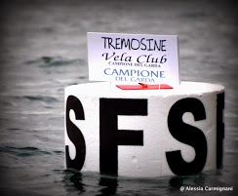
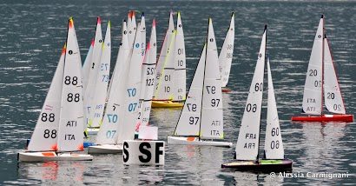
The sizes of course marks is 600mm x 300mm.
The marks are white and black letters/numbers.
The radio frequency bands available for competitors are 35-40-41 Mhz/ 2.4 Ghz. There are any restrictions.

Slide 6
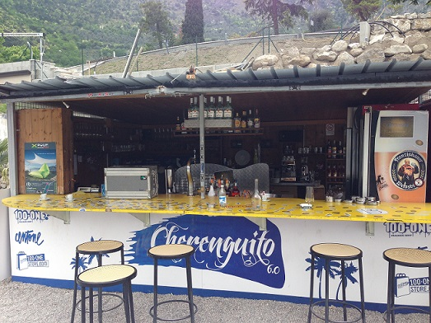
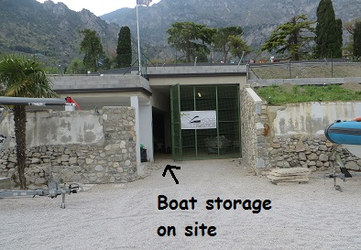
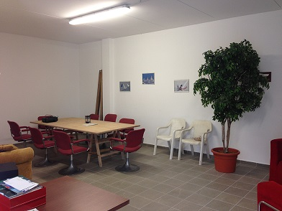
SAILING SITE FACILITIES
AVAILABLE:
- Boat storage on site.
- Interpreters with English, French and German.
- Male and Female lavatories on site.
- Food and drinks cafeteria.
- Shelter for rain and/or strong sun.
- Cabins, tents or rooms for the Race Committee & Jury.
- Battery charging facilities, voltage and plug types.
Repair facilities for yachts.
Internet
Wi-fi

Slide 7
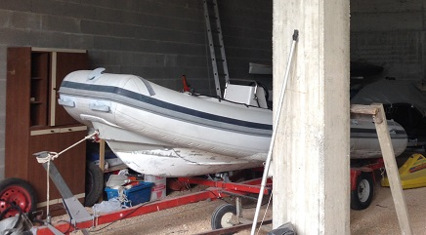
RACE MANAGEMENT
There are two rubber boats with 40hp engines for mark laying and two rubber boats with 25hp and 40hp engines for boat rescue.
For race there are public address system that can be heard over
entire site, device for playing and back-up start sequence, device
for recording finishing order, radio frequency, computer for
scoring and race notice board, course board, heat board, score
board.
For the control of boat there are weighing scales, sail
measurement equipment, covered facilities for measurement
both pre-event and during the event.
There is not measuring tank.

Slide 8
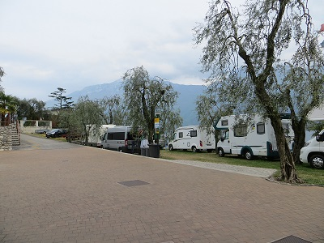
ACCOMMODATION AND
SOCIAL ARRANGEMENTS
Car parking free near the race area. Camping and hotels.
This camping is located 50m from the race area.
www.campingnanzel.it
The price will be determined by the structure and arrangement for the event.
This is in front of the lake and include a beach and snack bar.
There is another camping with the same service;
www.hghotels.com

Slide 9
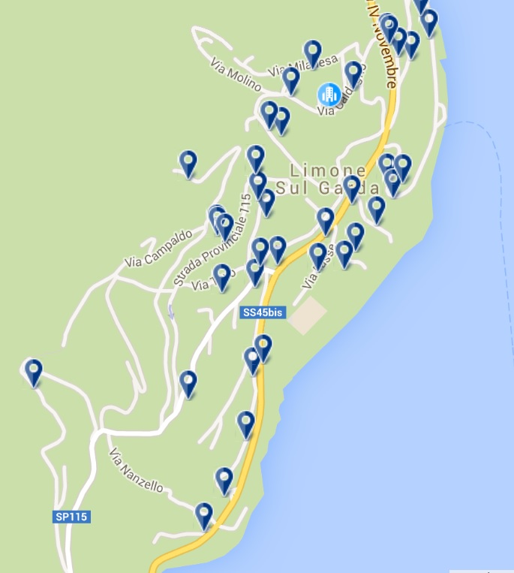
In Limone sul Garda are available some hotels, bed&breakfast, apartments or residence.
The structure is visible on site www.limonehotels.com
For the price, the structure will decide for the period with arrangements and exclusive packages.
The distance of airport are:
Valerio Catullo, Verona 100km
Orio al serio, Bergamo 120km
Linate, Milano 170km
Malpensa, Milano 210km
For information on Limone sul Garda visit
www.visitlimonesulgarda.com

Slide 10
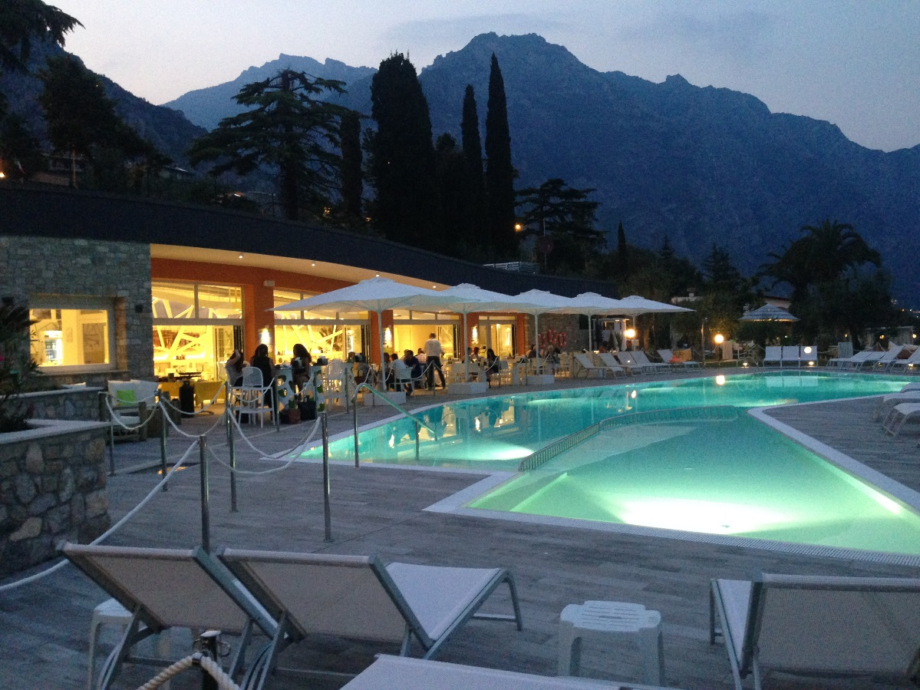
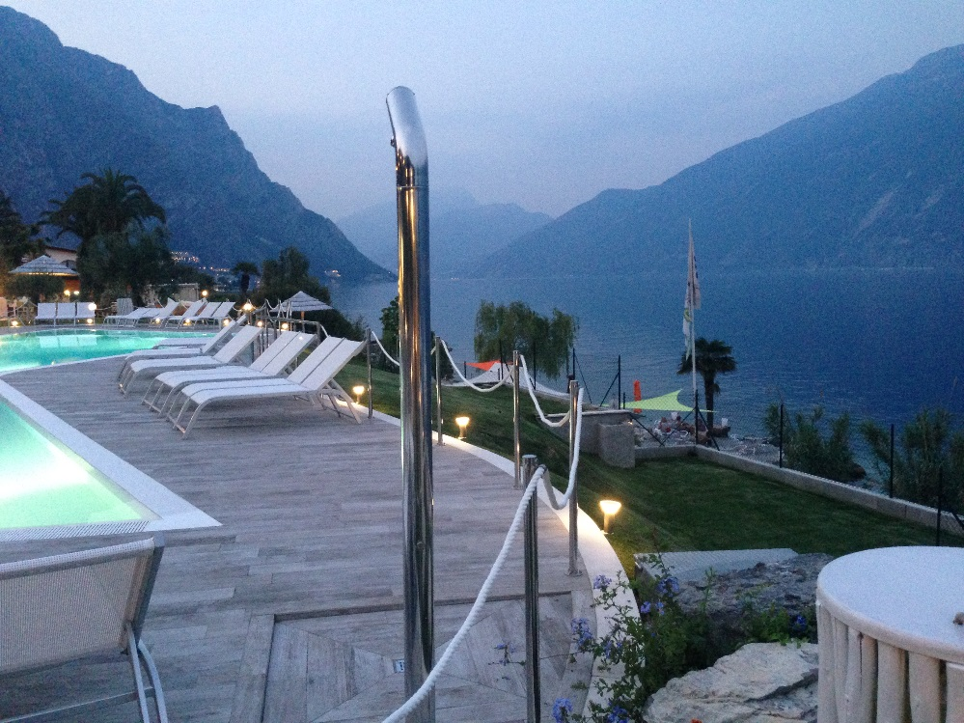
In this place there are more restaurant and snack bar.
There is a new restaurant with pool and spa area.

Slide 11
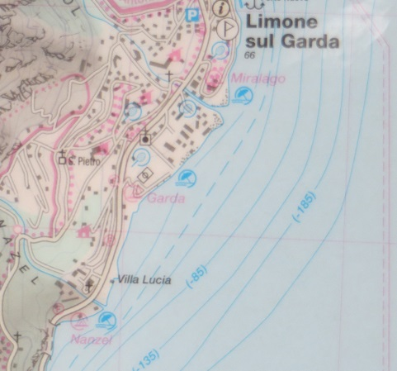
EVENT MANAGEMENT AND FINANCE
The entrance fee is more or less € 350,00 - £ 255,00
For financial assistance and funding there is private or business sponsorship
The organization will be run by the staff of the club “Vela Club Campione” which have successfully organized the “Moth World 2012 Championship” and the IOM European Championship 2014, and with collaboration of “Circolo Vela Limone”.
Vela Club Campione and Circolo Vela Limone are affiliated to the FIV Italian Sailing Federation (Federazione Italiana Vela).

Slide 12
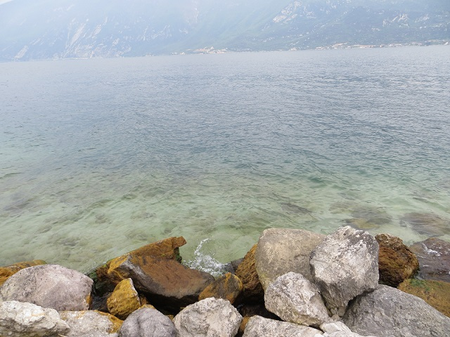
The plans to secure the services of sufficient and experienced staff to run the event is:
Event Chairman: VIRGINIO BOGLIETTI
Chief Race Officer: PIERRE GONNET
Race Officer : RENATO BOLIS
Race Committee with international members with experience in similar events
- Chief Measurement Officer (MO) and 3 assistant
- Auxiliary staff for heat Management
- 7 International Jury and Umpire:
- Web Service

Slide 13
We are pleased to inform you that on 16-17-18 October 2015, will be held in the same place, the Garda Lake International Marblehead Meeting.
An excellent opportunity to test the race course for the next World Championships in September 2016.

